Slide 1
Laser Propulsion of Nanosat to Low Earth Orbit
Dr Harshal Oza
Sakshi Shrivastava (AU1401090)

Slide 2
Chemically propelled rockets - a limitation
The most distant space probe, voyager 1, has been travelling for about 42 years currently at the speed of 17 km/s or 0.006% of light speed. It will take it another 300 years to cross the outer edges of solar system.
This impedes research. In the vast distances of space, we are hemmed by our solar system. We want to look closely at other solar systems and celestial objects for more data. Looking from afar can only get us so much.
Mass of rockets becomes an issue, limiting speeds achieved.

Slide 3
Looking towards other forms of propulsion
How do we solve the speed issue?
Directed energy
Nuclear Fission-Fusion engine
Ion engine
Antimatter engine
Nuclear thermal
What if we could leave the engine at home?

Slide 4
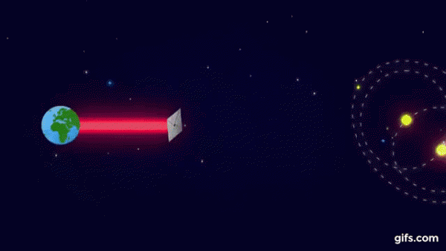
Directed energy propulsion
The basic idea is to provide thrust to spacecraft using photons.
We can ‘sail’ using this photonic wind.
Laser ablative propulsion.
Space debri removal.
Gram scale spacecrafts.

Slide 5
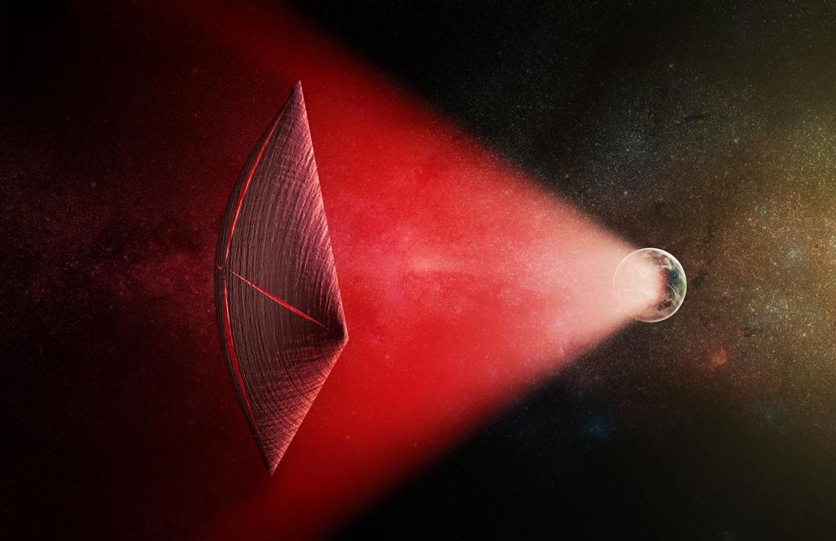
Different types of sail
Solar sail: As we head deeper into space, weaker would be solar energy.
Magnetic or electric sail:
Uses static magnetic field to deflect charged particles radiated by the Sun as a plasma wind.
Could achieve 0.1% c eventually from repeatedly achieving close proximity with stars, they estimated that this would take 10,000 encounters over the course of one million years.
Laser sail: Directed lasers. Achieves 10% c.

Slide 6
Some equations
a = acceleration
c = speed of light
dspot = laser spot size
D = diameter of laser optics
r = distance from laser to sail
λ = laser wavelength
n = sail reflectance
Δv = change in velocity
M = sailscraft mass
P = laser power
t = time

Slide 7
Some equations
Forward’s equation for acceleration of laser sail (1989):
a = [2 * n * P] / [M * c]
Size of sail
Sail diameter = diameter of beam at its operational range
> unecessary mass and acceleration decreases
< energy wastage and inefficiency
dspot = 2.44 * λ * r / D
λ = c/v; c = dspot * D * v / 2.44r
a = [2 * n * P * 2.44r] / [M * dspot * D * v ]

Slide 8
Scope of BTP
Project glowworm: achieving a 10 km altitude change using laser propulsion in low earth orbit.
Well defined orbital mechanics.
Study dynamics of laser propelled spacecraft and identify control parameters.
Synthesize guidance and control equations for the system.

Slide 9
Challenges ahead
Laser power station - power requirement, generation, efficiency
If ground based - atmospheric perturbation
Economic issues - 100x reduction
Material issue for sail and sailcraft
Radiation damage - extreme front edge damage
Interstellar Communication

Slide 10
Who is working on this problem
NASA, Breakthrough Starshot initiative. Established by Yuri Miller (billionare, investor) and Stephen Hawking (physicist). [1]
Headed by Dr Philip Lubin, professor at UC Santa Barbara. He wrote the white paper for interstellar flight using laser propulsion. [2]
Initiative for Interstellar studies: Project Glowworm. [3][4]

Slide 11
References
https://breakthroughinitiatives.org/initiative/3
https://www.deepspace.ucsb.edu/wp-content/uploads/2015/04/A-Roadmap-to-Interstellar-Flight-15-o.pdf
https://i4is.org/what-we-do/technical/project-glowworm/
https://www.researchgate.net/publication/328202365_Project_Glowworm_Testing_Laser_Sail_Propulsion_in_LEO
https://www.universetoday.com/143992/whats-the-best-way-to-sail-from-world-to-world-electric-sails-or-solar-sails/

